Slide 1
SUPERSTORE PRODUCT SALES OVERVIEW
Created by Annapoorna Choudi

Slide 2
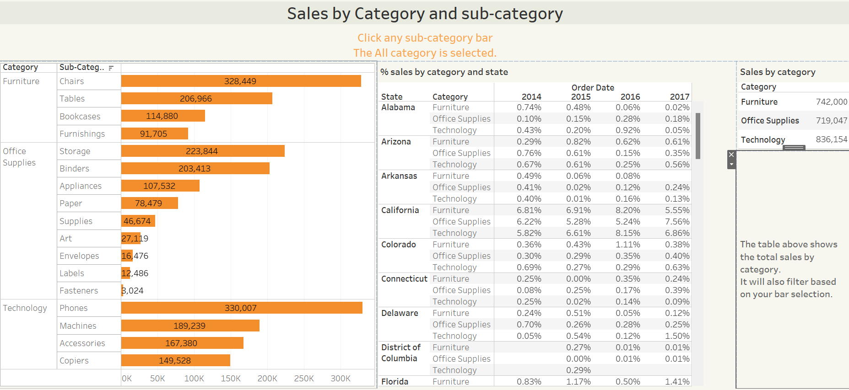

Slide 3
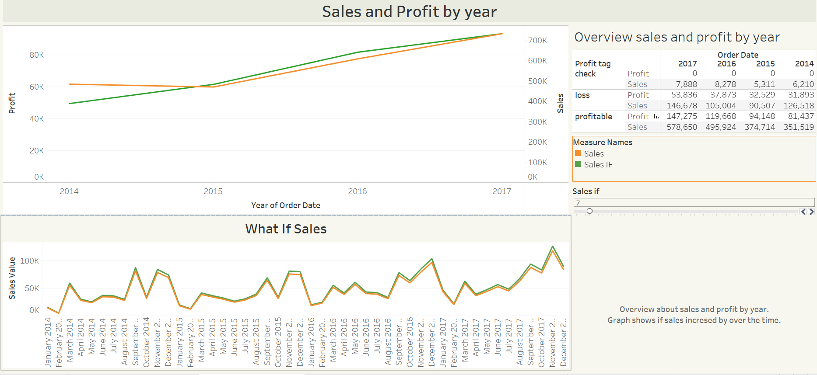

Slide 4
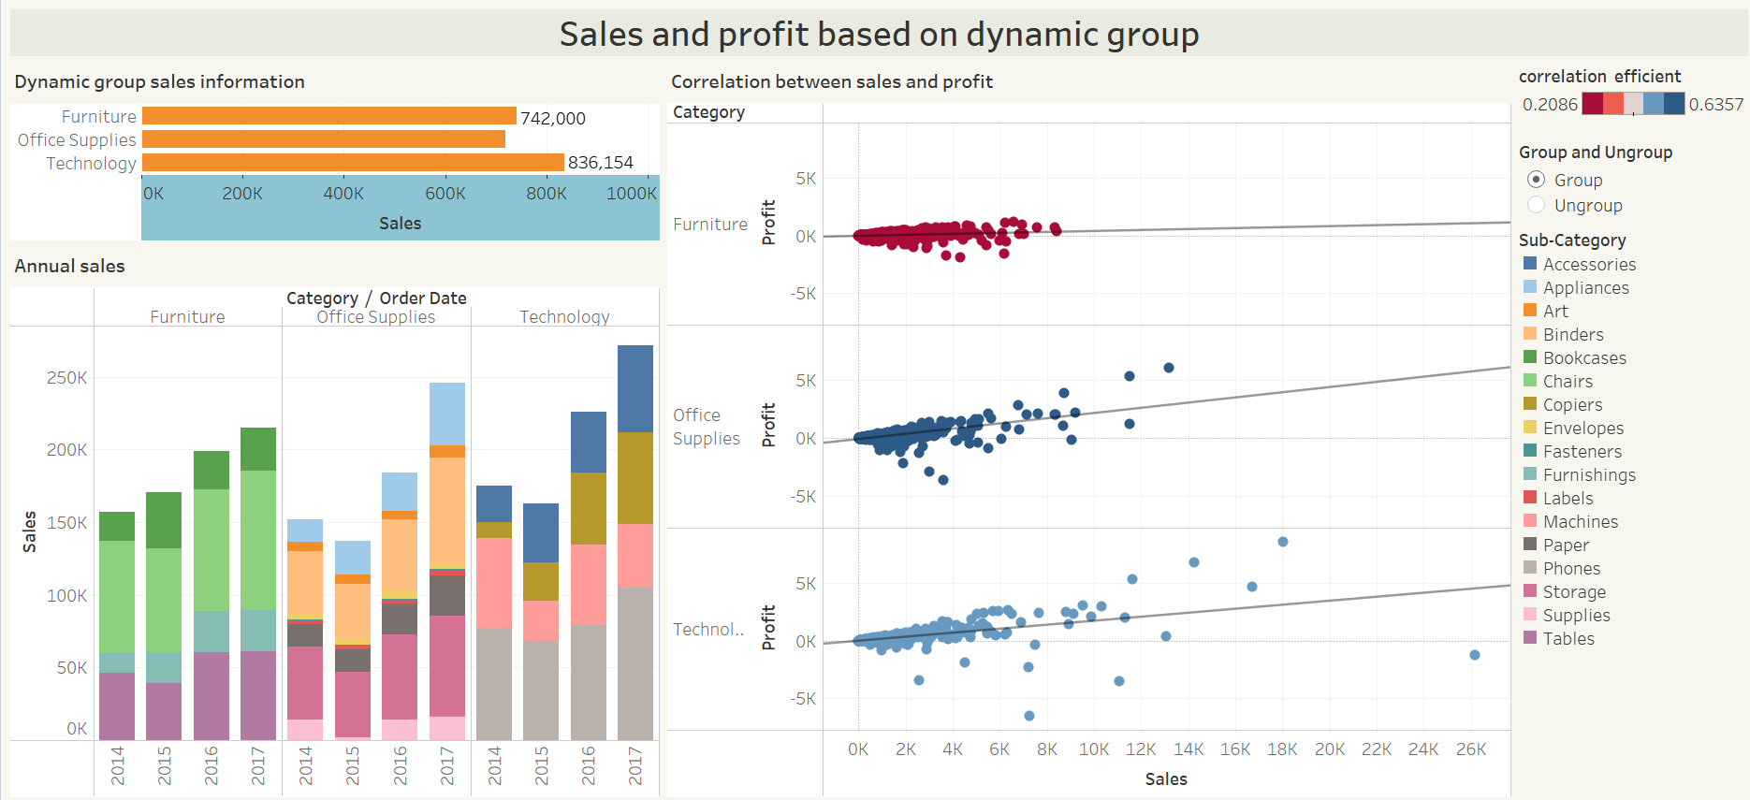

Slide 5
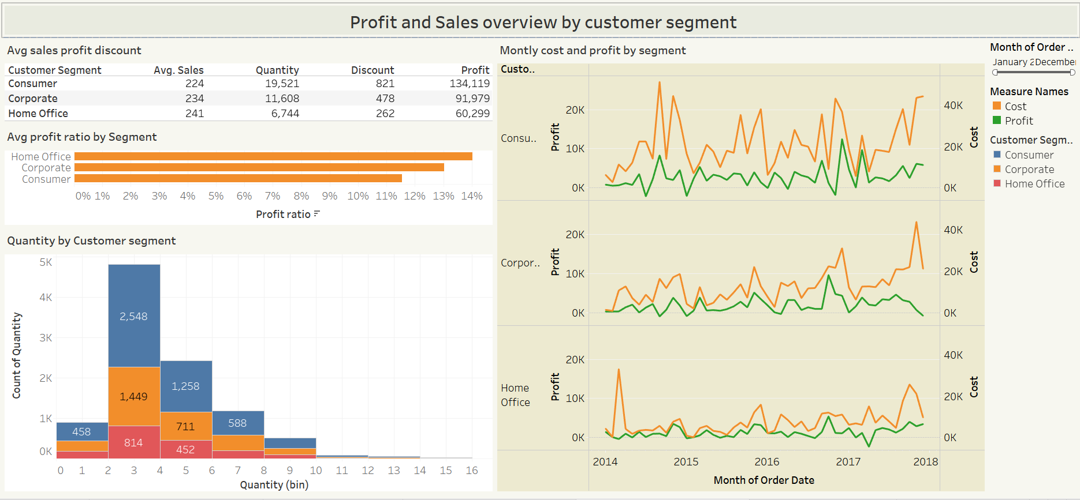

Slide 6
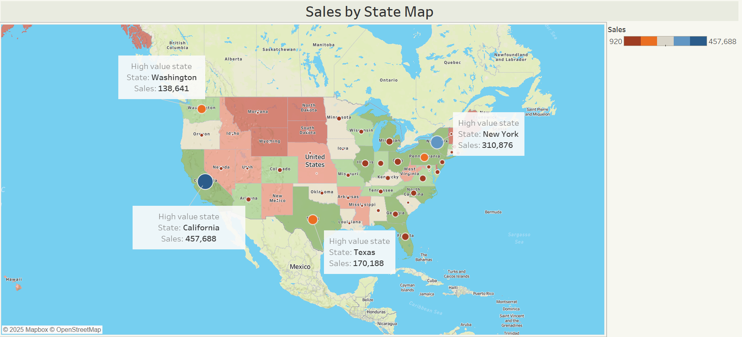

Slide 7
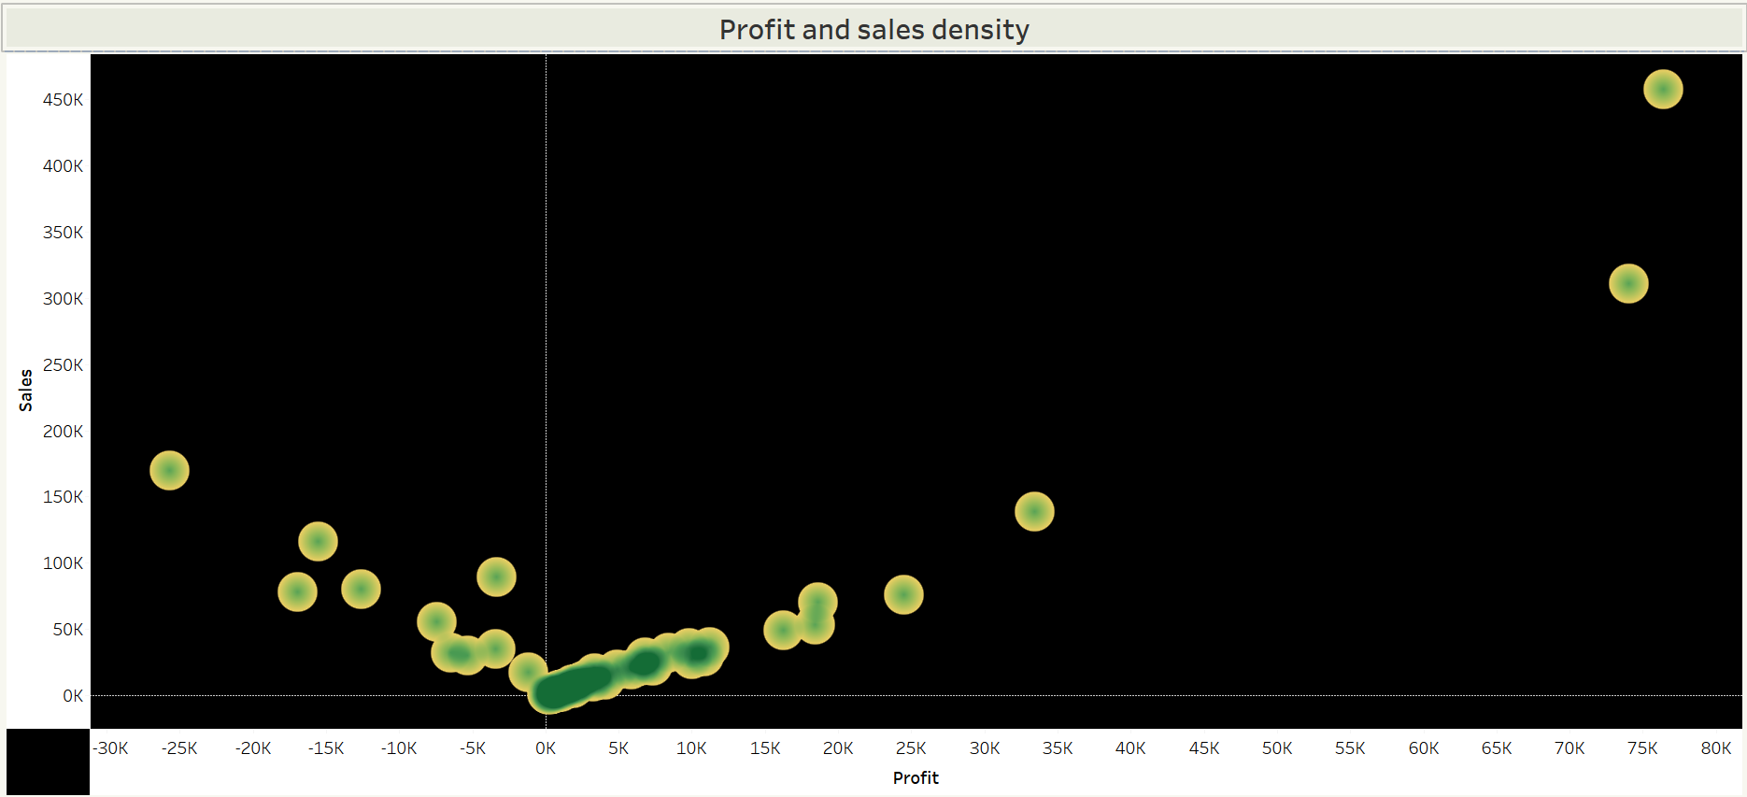

Slide 8
This Tableau report provides additional insights and supports the analysis presented.
Reference report from Tableau

